Slide 1
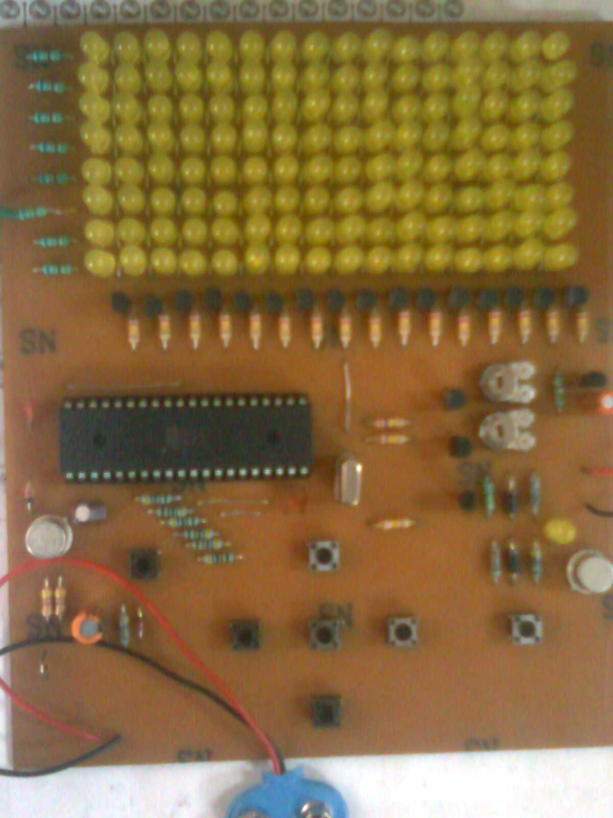
Snake game on AT89S51 microcontroller Instructor – Mrs. Asha Nayar
By
Sumit chouhan
Vivek shah

Slide 2
Agenda
We will be explaining this game that how we have made this game so that you can also develop it if you want.
We have divided this game in two parts to make it easy to understand.
Hardware development
Coding

Slide 3
Hardware development
We would be explaining how we have made the hardware circuit.
For preparing a circuit there are two ways either you can make circuit on breadboard or you can make it on pcb.
We found pcb more appropriate for us.

Slide 4
Hardware development
You need to have a circuit diagram of whatever you are making.
Making layout- you can use soft wares like eagle , pcb123, pcb express. or you can prepare it manually.
Printing layout on the pcb can be done scanning also.
Etching : generally we use ferrous chloride hot water solution for etching. we put our pcb in any plastic basket and in one or two hour etching gets completed. That’s how we remove the unnecessary copper from pcb.

Slide 5
Hardware development (conti.)
4. Drilling : we need to make holes to put the components in there respective positions.
5. Soldering.
We are done in hardware preparation.

Slide 6
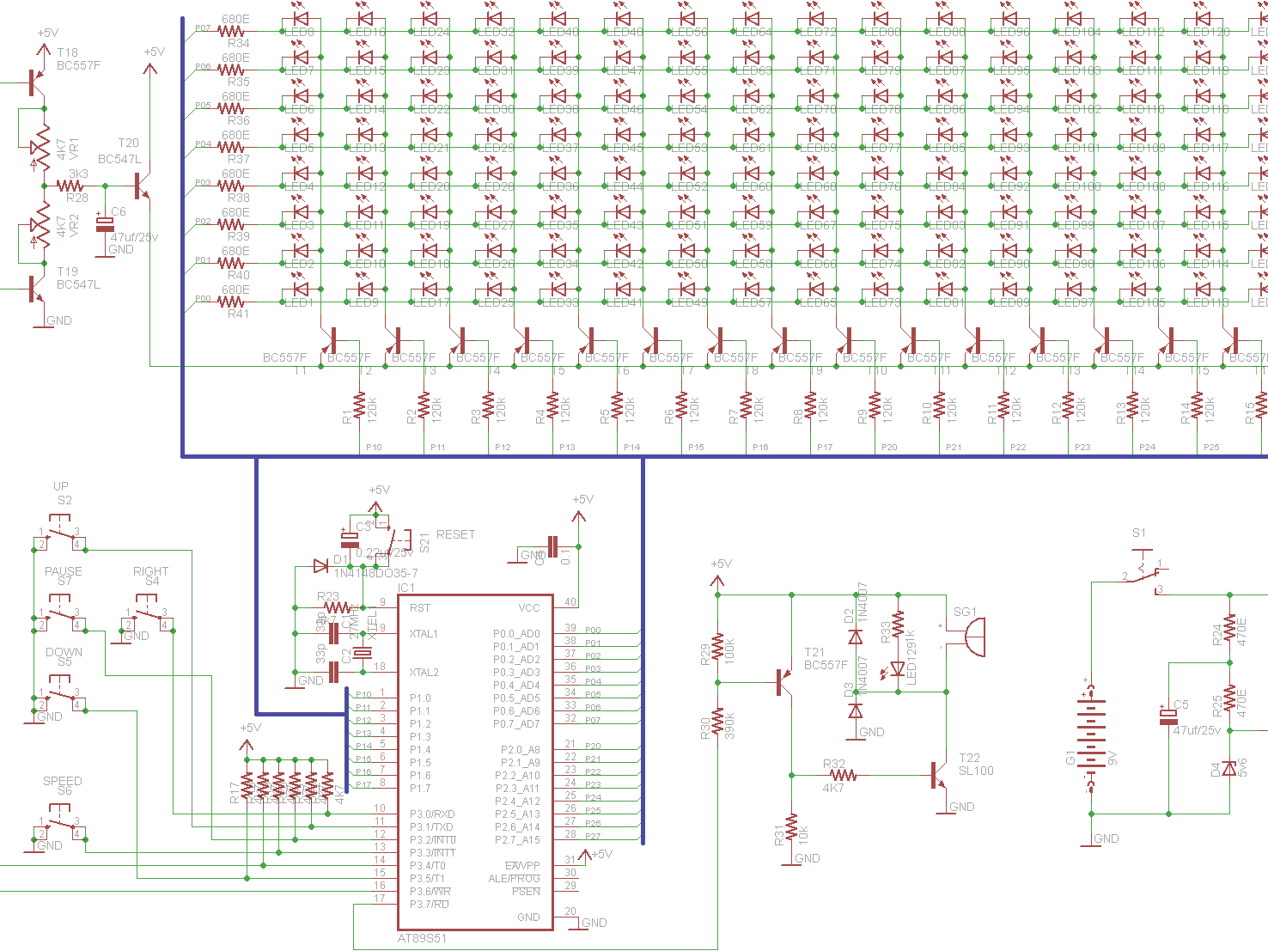
Circuit diagram

Slide 7
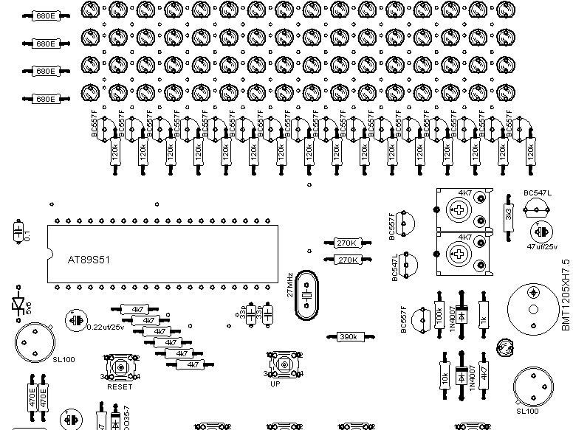
Top view of layout

Slide 8
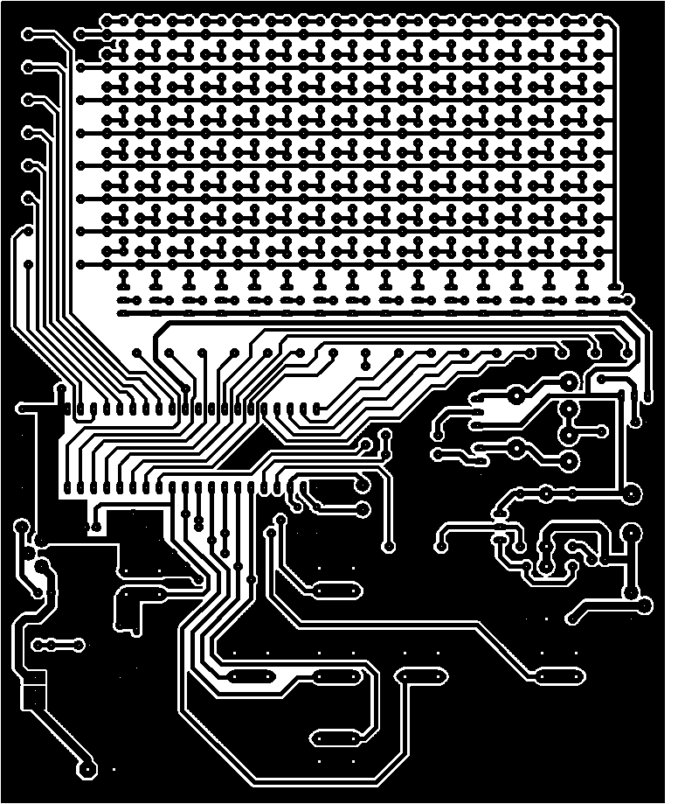
--Layout

Slide 9
Coding
We are using AT89S51 microcontroller.
You need to be familiar with all the instructions set of this microcontroller. And you will also be needing the datasheet of this.
We used keil u Vision3 to assemble the code.
You can prepare a hex file. Than u just need to burn the hex file in microcontroller.

Slide 10
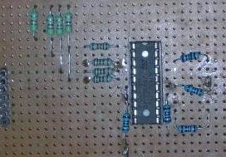
Microcontroller programmer
Microcontroller programmer is a device which is used to load the program(.hex file ) from host PC to the target microcontroller.

Slide 11
Coding
After burning just put your microcontroller in the hardware it’s done now.
Just enjoy the game.

Slide 12
Thanks for listening us very silently.
You can ask any of doubts if you have.

